Slide 1

Basic of C Programming
Concept of Operators

Slide 2
C Operators -
An Operator is simply a symbol that is used to perform operations. There can be many types of operations like arithmetic, logical, bitwise, shift etc.
Operators
Unary Operators
Binary Operators
Ternary Operators
Special Operators

Slide 3
Unary Operators -
Unary Operators are operators that act upon a single operand to produce a new value.
Unary Operators
Unary Plus (+)
Unary Minus (-)
Increment (++)
Decrement (--)
Not (!)

Slide 4
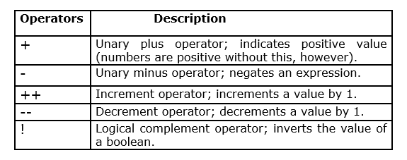
Unary Operators – in details

Slide 5
#include<stdio.h>
#include<conio.h>
void main()
{
int x;
x = 100; //Unary Plus Operator
printf("\nValue is: %d",x);
x = -100; //Unary Minus Operator
printf("\nValue is: %d",x);
x = 99;
++x; //Increment (Prefix) Operator
printf("\nValue is: %d",x);
x++; //Increment (Postfix) Operator
printf("\nValue is: %d",x);
--x; //Decrement (Prefix) Operator
printf("\nValue is: %d",x);
x--; //Decrement (Postfix) Operator
printf("\nValue is: %d",x);
}

Slide 6
Binary Operators -
Binary Operators are those operators that work with two operands. The binary operators are further subdivided into arithmetic, relational, logical, and assignment operators.
Binary Operators
Assignment
Arithmetic
Relational
Logical
Bitwise
Shift

Slide 7
Assignment Operators -
Assignment Operators are used to combine the “=” operator with one of the binary arithmetic operators.
An assignment operator is used for assigning a value to a variable.
Operators | Example | Same As
= | a = b | a = b
+= | a += b | a = a + b
-= | a -= b | a = a – b
*= | a *= b | a = a * b
/= | a /= b | a = a / b
%= | a %= b | a = a % b

Slide 8
Arithmetic Operators -
Arithmetic Operators are used to perform numerical calculations among the values.
Operators | Meaning of Operators
+ | Addition or unary plus
- | Subtraction or unary minus
* | Multiplication
/ | Division
% | Modulo Division

Slide 9
Relational Operators -
A Relational Operator checks the relationship between two operands. If the relation is true, it returns 1; if the relation is false, it returns value 0.
Relational operators are used in decision making and loops.
Operators | Meaning of Operators | Example
== | Equal to | a == b
> | Greater than | a > b
< | Less than | a < b
!= | Not equal to | a != b
>= | Greater than or equal to | a >= b
<= | Less then or equal to | a <= b

Slide 10
Thank you…!

